Slide 1


TURKISH CAPITAL MARKETS
OCTOBER 2026

Slide 2


CONTENTS
3
Structure of the Turkish Financial Markets
15
Turkish Capital Markets Association
23
Turkish Capital Markets
48
Investment Institutions
71
Investor Profile

Slide 3
STRUCTURE OF THE TURKISH CAPITAL MARKETS

Slide 4

CAPITAL MARKETS BACKGROUND
1982: Capital Markets Board established.
1985: Istanbul Stock Exchange (ISE) established.
1992: Takasbank (Settlement & Custody Bank) established.
1995: Istanbul Gold Exchange (IGE) established.
1997: Banks are forbidden to trade equities.
2001: Association of Capital Markets Intermediary Institutions of Turkey established.
CSD of Türkiye (MKK) established, Investors' Protection Fund established.
2002: Private pension system introduced.
2005: IFRS adopted for financial intermediaries and listed companies,
Turkish Derivatives Exchange (TurkDex) established.
Dematerialization of equities completed.
2006: Dematerialization of corporate bonds & mutual funds completed.
2009: Automated Disclosure Platform introduced.
Istanbul International Financial Centre strategy announced.
4
4

Slide 5
CAPITAL MARKETS BACKGROUND
2011: Forex regulation passed.
2012: New Capital Markets Law passed.
ISE demutualised and merged with Istanbul Gold Exchange under Borsa Istanbul.
2013: Borsa Istanbul announced strategic partnership with Nasdaq, Borsa Istanbul and TurkDex merged.
2014: The structure of the Association has changed and the membership base was expanded to cover asset management companies and investments trusts, in addition to brokerage firms and banks. The name of the Association was revised to Turkish Capital Markets Association.
2015: Takasbank introduced the Electronic Fund Distribution Platform TEFAS.
Borsa Istanbul introduced new trading platform BISTECH.
2016: TCMA arbitration committees established.
Turkey Wealth Fund established.
2017: Auto-enrollment in the private pension system introduced.
2018: Presidential Finance Office established.
2019: TURIB- e-Warehouse Market started to operate.
Equity based crowdfunding regulations introduced.
2021: Takasbank launched the private pension fund trading platform BEFAS.
New crowdfunding regulations introduced.
2022: Guidelines on green and sustainable debt instruments and lease certificates released.
2023: Turkey Sustainability Reporting Standards released.
2026: Crypto-asset service providers and crowdfunding platforms will become members of the Association.
5

Slide 6
Regulatory Structure of the Financial Markets
Banking
Capital Markets
Insurance
Payment System
Banking Regulation and Supervision Agency (BRSA)
Capital Markets Board (CMB)
Insurance & Private Pension Regulation and Supervision Agency
The Central Bank of Turkey
-Banks’ Association of Türkiye
-Participation Banks’ Association of Turkey
-Association of Financial Institutions
-Turkish Capital Markets Association
-Borsa Istanbul
-Turkish Appraisers Association
-Insurance Association of Turkey
-Pension Monitoring Center
The Association of Payment and Electronic Money Institutions of Turkey
-Insurance Companies
-Pension Companies
-Pension Funds
-Payment Institutions
-Electronic Money Institutions
-Banks
-Participation Banks
-Savings Deposit Insurance Fund
-Leasing Companies
-Factoring Companies
-Consumer Finance Companies
-NPL Management Companies
-Rating, Audit Firms
-Financial Holding Companies
-Banks
-Brokerage Firms
-Asset Management Firms
-Investment Trusts
-CSD of Türkiye
-Settlement and Custody Bank
-Capital Markets Licensing and Training Agency
-Investor Compensation Center
-Public and Listed Companies
-Rating, Appraisal, Audit Firms
-Crowdfunding Platforms
-Crypto Asset Transaction Platforms
6

Slide 7
Capital Markets Board
Capital Markets Board (CMB) is the main regulatory and supervisory authority for the securities markets and institutions in Turkey.
The Board is responsible for the protection of rights and interests of investors.
The CMB’s jurisdiction areas:
          Primary markets
  Secondary markets
  Investment services
7

Slide 8
BORSA ISTANBUL
Borsa Istanbul, formerly named as Istanbul Stock Exchange, was established in 1985.
The exchange was demutualised in 2013.
The exchanges operating in Turkey, namely Istanbul Stock Exchange, Istanbul Gold Exchange and the Turkish Derivatives Exchange merged under the roof of Borsa Istanbul.
The main markets and the traded securities on Borsa Istanbul are:
          Equity Market: Shares, rights coupons, ETFs, warrants, certificates, real estate and venture capital investment funds; Turkish state mint certificates.
  Debt Securities Market: Government bonds, corporate bonds, asset-backed securities, Islamic bonds, repo-reverse repo transactions, Turkish eurobonds, money market and swap transactions.
  Derivatives Market: Single stock, equity index, foreign currency, physically delivered FX, precious metals, energy, foreign index and interest rate futures, single stock, currency, equity index, USDTRY and physically delivered USDTRY options.
  Precious Metals and Diamond Market: Gold, silver, platinum and palladium.
8

Slide 9
Takasbank (Istanbul Settlement and Custody Bank)
Takasbank was established in 1988 as a department of Borsa Istanbul, It was incorporated as a separate company in 1992 and became a non-deposit taking bank in 1995.
Takasbank is:
  The clearing and settlement center for Borsa Istanbul
  The central counterparty for Borsa Istanbul Futures & Options, Debt Securities, Equities, Money and Swap markets
  The national numbering agency of Turkey
Services offered:
  Securities Lending & Borrowing Market and Takasbank Money Market (Takasbank acts as CCP in those markets)
  Clearing and central counter party services for Turkish lira interest rate swap and overnight index swap contracts in OTC markets
  Custodian to private pension system
  Operates the electronic fund (TEFAS) and private pension fund (BEFAS) distribution platforms
  Record keeping for leveraged transactions and collateral management as trade repository.
9

Slide 10
CSD of Türkiye (MKK)
CSD of Türkiye (MKK) was established in 2001 as a private company.
MKK is:
  The central securities depository for dematerialised securities including all publicly traded equities, mutual funds, government debt instruments (non-bank holdings only), corporate bonds and bills, asset backed securities, warrants real estate certificates, mint certificates and electronic warehouse receipts.
  A securities settlement system operator (Centralised Dematerialised System).
  The trade repository for the reporting of derivatives and fixed income transactions.
MKK also runs various electronic services for investors and companies:
  Operates the Public Disclosure Platform (KAP); the single information platform on listed companies and investment funds.
  Operates the Electronic General Meeting System (e-GENELKURUL); the single electronic platform for general meeting processes in Türkiye.
  Provides investor information services through its e-YATIRIMCI platform.
  Provides data on capital markets via its Data Analysis Platform (VAP).
  Provides integrated crowdfunding services through its KFS system for crowdfunding platforms.
  Acts as the registration centre for bearer shares of unlisted joint-stock companies through its HPKS system.
10

Slide 11
Investor Compensation CentRE
Investors’ Protection Fund, which covered equity settlement obligations, was established in 2001.
Investor Compensation Centre replaced the Investors’ Protection Fund in 2013 with the renewed Capital Market Law.
It covers settlement obligations of all capital market instruments, up to TL ​​2,065,145 in 2026, in case of liquidation or bankruptcy of investment institutions.
All investment institutions must be a member of the Investor Compensation Centre.
11

Slide 12
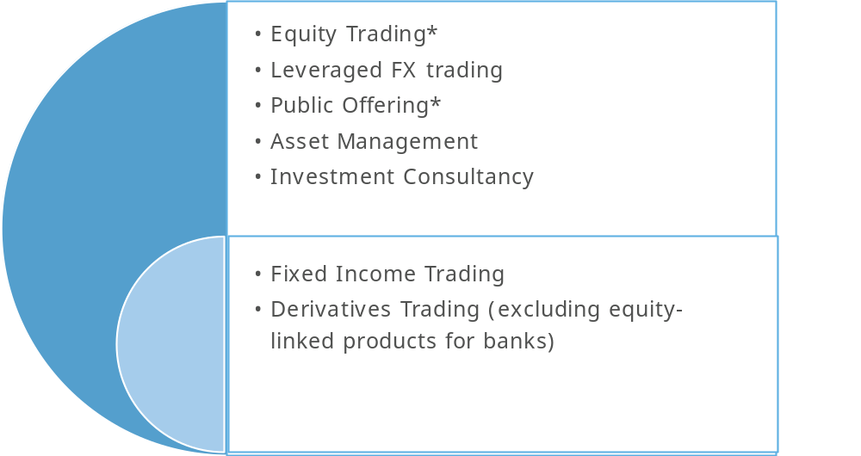
Activities of Intermediaries
BROKERAGE FIRMS
BANKS
*Authorized activities for investment banks
12

Slide 13
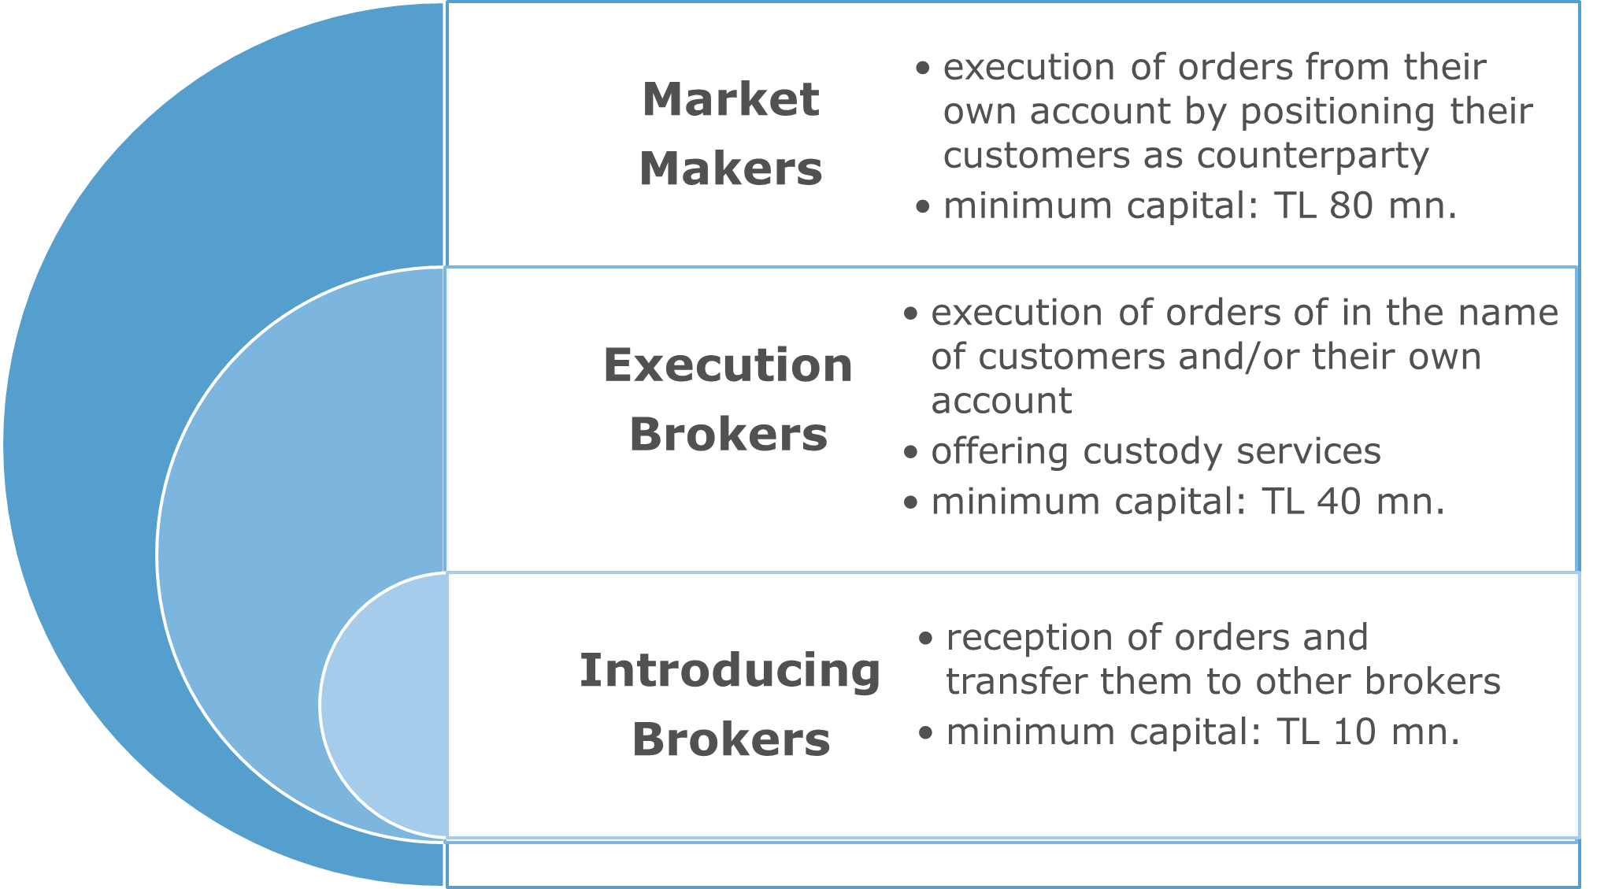
Types of brokerage fIrms
Execution of orders from their own account by positioning their customers as counterparty
Minimum capital: TL 380 mn.
Execution of orders of in the name of customers and/or their own account
Offering custody services
Minimum capital: TL 190 mn.
Reception of orders and transfer them to other brokers
Minimum capital: TL 45 mn.
13

Slide 14
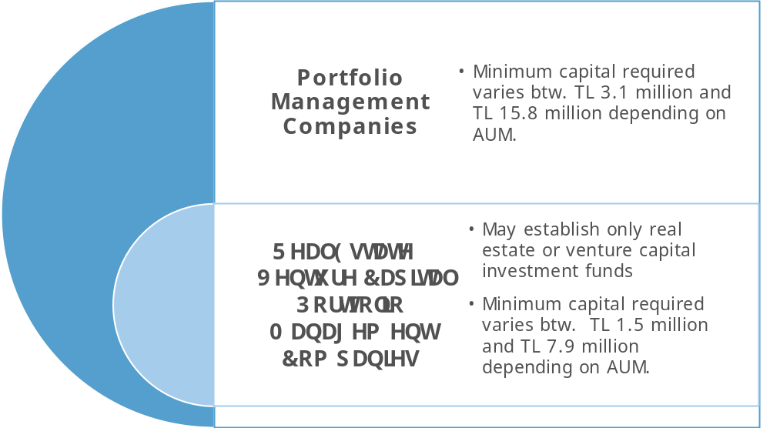
ASSET MANAGEMENT COMPANIES
Portfolio Management Companies
Minimum Capital required varies btw. TL 150 million and TL 480 million depending on AUM.
Real Estate/ Venture Capital
Portfolio Management Companies
May establish only real estate or venture capital investment funds
May establish only real estate or venture capital investment funds
Minimum Capital required varies btw. TL 75 million and TL 240 million depending on AUM.
14

Slide 15
TURKISH CAPITAL MARKETS ASSOCIATION

Slide 16

TCMA
TCMA is the self-regulatory professional organization in the Turkish capital markets.
Brokerage firms, banks, asset management companies, and investment trusts are members of the Association.
Founded in April 2001 according to the Capital Markets Law.
Membership base expanded in 2014 with new law.
Membership is mandatory.
Under CMB supervision.
16

Slide 17
MEMBERS
17

Slide 18
AIMS
Contribute to the development of the capital market.
Meet the collective needs of members and facilitate solidarity among its members.
Prevent unfair competition between its members.
Enhance know-how in the sector.
18

Slide 19
FUNCTIONS
Establish code of ethics for the profession.
Establish professional rules and regulations.
Conduct research.
Offer educational programs.
Assist in the resolution of disputes.
Cooperate with related foreign institutions.
Engage in financial literacy activities.
19

Slide 20
NATIONAL MEMBERSHIPS
Foreign Economic Relations Board of Turkey (DEİK), founder member since 2008.
Tax Council, member since 2013.
Istanbul Arbitration Center (ISTAC), member since 2017.
Impact Investing Advisory Board (EYDK), member since 2021.
20

Slide 21
INTERNATIONAL MEMBERSHIPS
Asia Securities Forum (ASF) member since 2009.
OECD International Network on Financial Education (INFE) affiliate member since 2015.
International Council of Securities Associations (ICSA) member since 2006.
International Organization of Securities Commissions (IOSCO) affiliate member since 2003.
21

Slide 22
PARTICIPATIONS
5% stake
one seat at the board of directors, out of 8 members
1.3% stake
49% stake
2 seats at the board of directors, out of 7 members
6% stake
TURKEY SECURITIZATION COMPANY
5% stake
CENTRAL SECURITIES DEPOSITORY
BORSA ISTANBUL
CAPITAL MARKETS LICENSING & TRAINING AGENCY
JCR EURASIA CREDIT RATING AGENCY
22

Slide 23
TURKISH CAPITAL MARKETS

Slide 24
BIST-100 Index & Trading Volume
Source: Borsa Istanbul
24

Slide 25
Market Capitalization of Borsa Istanbul (BILLION TL)
Source: Borsa İstanbul
25
25

Slide 26
Breakdown of borsa Istanbul market Capitalization
Source: Borsa İstanbul
26
26

Slide 27
CONCENTRATION IN THE EQUITY MARKET (MCAP)
27
27
Source: Borsa İstanbul

Slide 28
Domestic Market Capitalization* (2026/06 BILLION $)
RANK
27
33,290
43,538
28
28
*WFE definition does not include mutual funds, exchange traded funds, investment trusts, unlisted firms and holding companies.
Source: WFE

Slide 29
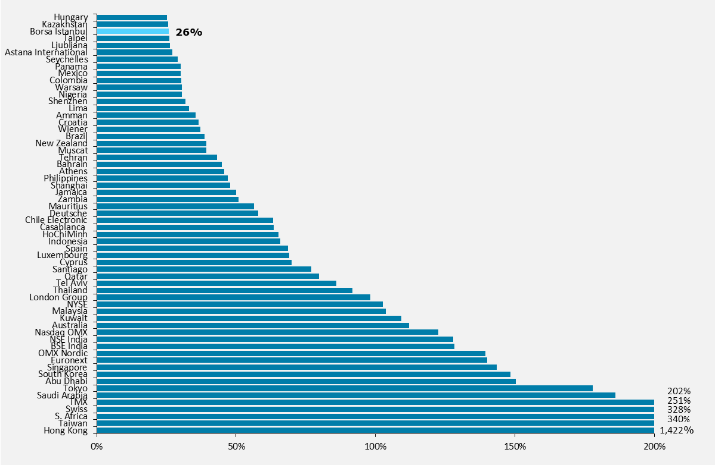
Market Capitalization/GDP* (2025)
RANK
58
29
*Only main markets
In USD terms
Source: WFE, IMF
29

Slide 30
Number of securItIes In THE equIty market
*Includes SubMarket, Structured Products and Fund Market, Equity Market for Qualified Investors and Commodity Market.
30
30
Source: Borsa İstanbul

Slide 31
Number of Listed Companies* (2026/06)
RANK
26
31
*Borsa Istanbul data excludes mutual funds, investment trusts and Pre-Market Trading Platform
31
Source: WFE

Slide 32
EquIty Trading Volume of Borsa Istanbul (Billion TL)
Source: Borsa İstanbul
32

Slide 33
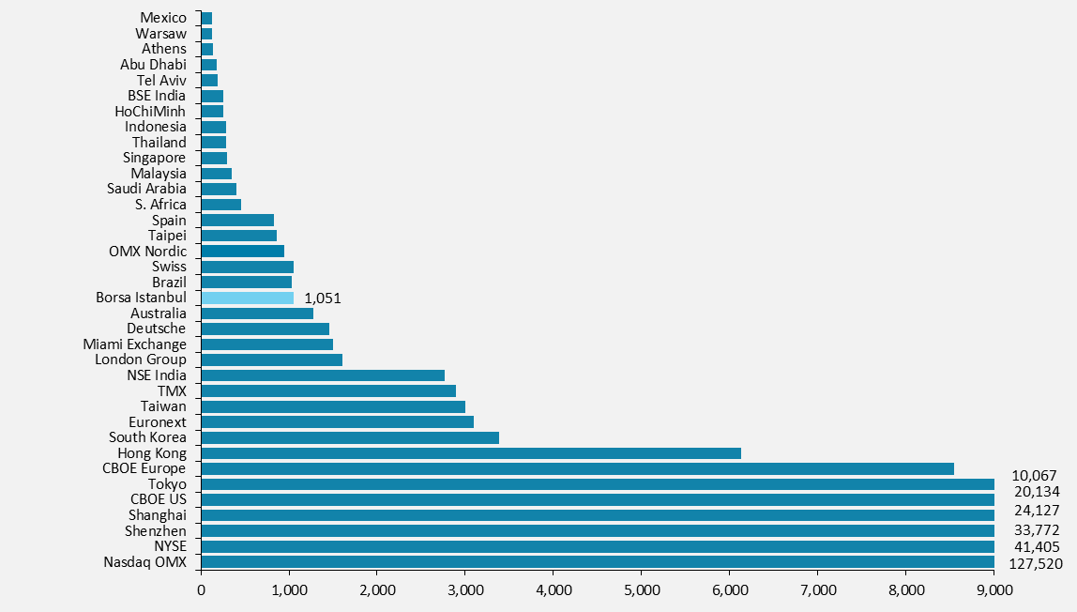
Equity Trading Volume (2025, BILLION $)
RANK
18
Source: WFE
33
Excluding London Stock Exchange.

Slide 34
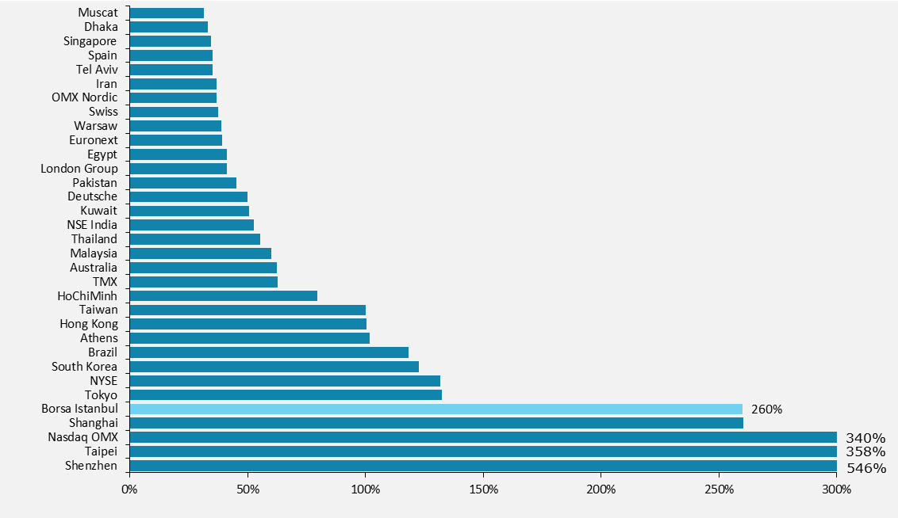
Turnover Ratio (2025, Equity Trading Volume/Market Capitalization)
RANK
5
34
Source: WFE
34
Excluding London Stock Exchange.

Slide 35
Securities Lending/Borrowing In borsa Istanbul (BILLION TL)
Source: Takasbank
35

Slide 36
Short Selling In borsa Istanbul
36
36
Source: Borsa İstanbul

Slide 37
MARGIN TRADING
Source: TCMA
37

Slide 38
Futures Trading Volume of borsa Istanbul
Source: Borsa İstanbul
38

Slide 39
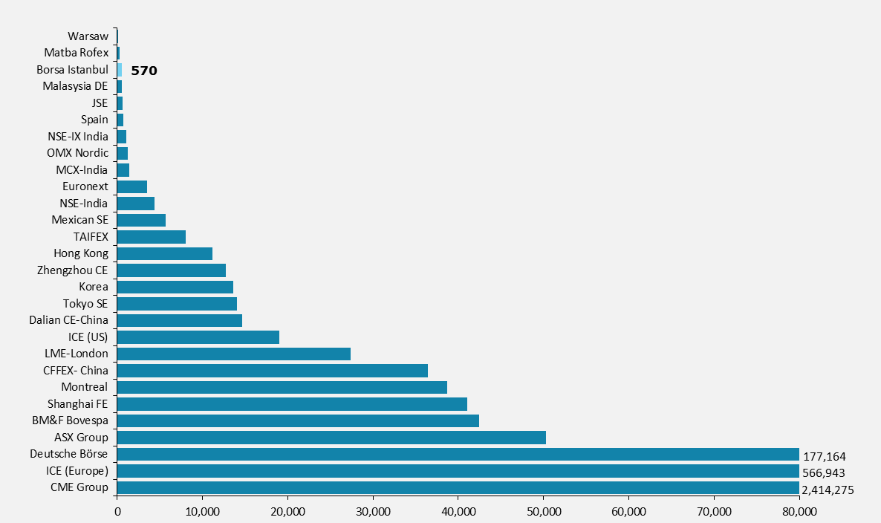
Trading Volume in Futures Markets (2025, BILLION $)
RANK
26
39
Source: WFE
39

Slide 40
Number OF LIsted corporate bonds IN BORSA ISTANBUL
Kaynak: WFE
40

Slide 41
MARKET VALUE OF DOMESTIC CORPORATE DEBT SECURITIES (BILLION TL)
41
41
Lease certificates included.
Source: CBRT

Slide 42
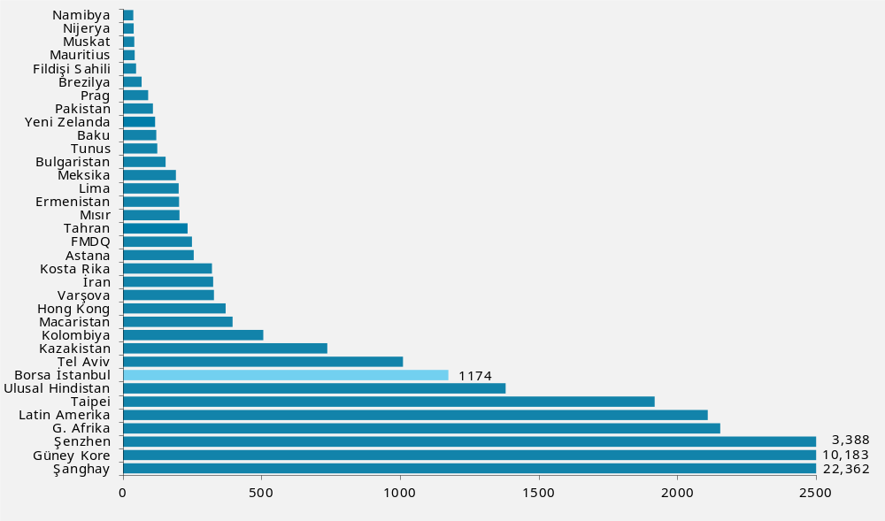
Number of Listed Corporate Bonds (2026/06)
RANK
8
42
42
Source: WFE, FESE

Slide 43
BOND TRADING VOLUME (BILLION TL)
43
43
OTC transactions included.
Source: Borsa İstanbul

Slide 44
REPO-REVERSE REPO, swap AND TAKASBANK MONEY MARKET
TRADING VOLUME (TRILLION tl)
44
44
OTC transactions included.
Source: Borsa Istanbul

Slide 45
Initial Public Offerings
45
45
*Investment Trusts included
Source: Borsa İstanbul

Slide 46
EQUITY FINANCING (BILLION TL)
46
46
Source: Borsa İstanbul

Slide 47
CORPORATE Debt Securities IssuANCE
47
47
Source: Borsa İstanbul

Slide 48
INVESTMENT INSTITUTIONS

Slide 49
Fixed Income Trading Volume of IntermedIarIEs (BILLION TL)
Excluding CBRT and Takasbank
Excluding Eurobond transactions,
OTC transactions included as of 31.03.2026
,
49
49
Source: Borsa İstanbul

Slide 50
Repo-Reverse Repo Trading Volume of IntermedIarIes (BILLION TL)
Excluding CBRT and Takasbank
OTC transactions included, as of 31.04.2025
Source: TCMA

Slide 51
Equity Trading Volume of Intermediaries (BILLION TL)
Source: Borsa Istanbul

Slide 52
Futures Trading Volume of IntermedıarıeS (BILLION TL)
Source: Borsa Istanbul
Excluding CBRT.

Slide 53
forex Trading Volume (Billion TL)
Source: TCMA

Slide 54
CONCENTRATION IN TRADING VOLUMES (2026/09)
Source: Borsa Istanbul, TCMA
Forex (Customer) as of February

Slide 55
Registration transactions are for the previous month
TOP 10 MEMBERS IN THE MARKETS (2026/09)
Equity Market
1 | YAPI KREDİ YATIRIM | 15%
2 | BANK OF AMERICA | 14%
3 | İŞ YATIRIM | 9%
4 | AK YATIRIM | 8%
5 | MİDAS MENKUL DEĞERLER | 4%
6 | TACİRLER YATIRIM | 3%
7 | DENİZ YATIRIM | 3%
8 | İNFO YATIRIM | 3%
9 | ZİRAAT YATIRIM | 3%
10 | GARANTİ YATIRIM | 3%
 | Toplam (myr. TL) | 100,428
Futures Market
1 | YAPI KREDİ YATIRIM | 22%
2 | İŞ YATIRIM | 12%
3 | AK YATIRIM | 8%
4 | BANK OF AMERICA | 5%
5 | QNB FİNANS YATIRIM | 5%
6 | DENİZ YATIRIM | 4%
7 | İNFO YATIRIM | 4%
8 | TEB YATIRIM | 4%
9 | GARANTİ YATIRIM | 3%
10 | YATIRIM FİNANSMAN | 3%
 | Toplam (myr. TL) | 60,489
Fixed Income Market*
1 | JPMORGAN | 14%
2 | İŞ BANKASI . | 9%
3 | GARANTİ BANKASI | 8%
4 | FİNANSBANK | 7%
5 | AKTİF YATIRIM BANKASI | 6%
6 | HSBC | 5%
7 | TÜRK EKONOMİ BANKASI | 4%
8 | VAKIFBANK | 4%
9 | AKBANK | 4%
10 | GEDİK YATIRIM | 3%
 | Toplam (trilyon TL) | 16,104
Forex Market (Customer)**
1 | GCM MENKUL DEĞERLER | 24%
2 | İNFO YATIRIM | 15%
3 | MEKSAYATIRIM | 13%
4 | İNTEGRAL YATIRIM | 11%
5 | QNB FİNANS YATIRIM | 7%
6 | NCM INVESTMENT MENKUL DEĞERLER | 7%
7 | GEDİK YATIRIM | 4%
8 | İŞ YATIRIM MENKUL DEĞERLER A.Ş. | 4%
9 | TRIVE YATIRIM | 3%
10 | PUSULA YATIRIM | 3%
 | Toplam (myr. TL) | 31,016
*Excluding Central Bank and Takasbank As off
**Leveraged Transaction as of the end of February
Source: Borsa Istanbul, TCMA

Slide 56
Number of Finalized Corporate Finance Deals (Brokerage Firms Only)
Source: TCMA

Slide 57
Institutional Investments (BILLION TL)
Source: Borsa Istanbul, TCMA
Mcap of investment trusts

Slide 58
Asset Management by Brokerage Firms
Source: TCMA

Slide 59
Asset Management by Asset Management Companies (bıllıon tl)
Source: TCMA

Slide 60
CONCENTRATION IN ASSET MANAGEMENT FIRMS (2026/08)
Source: TCMA

Slide 61
TOP 5 MEMBERS IN ASSET MANAGEMENT ACTIVITIES (2026/08)
Mutual Funds
1 | İŞ PORTFÖY | 11%
2 | GARANTİ PORTFÖY | 11%
3 | AK PORTFÖY | 10%
4 | ZİRAAT PORTFÖY | 9%
5 | YAPI KREDİ PORTFÖY | 8%
 | Toplam (milyar TL) | 11,014.1
Pension Funds
1 | ZİRAAT PORTFÖY | 20%
2 | AK PORTFÖY | 19%
3 | İŞ PORTFÖY | 18%
4 | GARANTİ PORTFÖY | 17%
5 | YAPI KREDİ PORTFÖY | 12%
 | Toplam (milyar TL) | 2,611.3
Discretionary Asset Management
1 | ZİRAAT PORTFÖY | 34%
2 | AZİMUT PORTFÖY | 14%
3 | PUSULA PORTFÖY | 10%
4 | AK PORTFÖY | 6%
5 | YAPI KREDİ PORTFÖY | 5%
 | Toplam (milyar TL) | 2,223.6
Investment Trusts
1 | PARDUS PORTFÖY | 45%
2 | ROTA PORTFÖY | 38%
3 | METRO PORTFÖY | 10%
4 | HEDEF PORTFÖY | 5%
5 | V PORTFÖY | 2%
 | Toplam (milyar TL) | 2.32
Source: TCMA

Slide 62
Brokerage Fırms’ Branch Network
Source: TCMA

Slide 63
Brokerage Fırms’ Employees
8,075
8,001
7,968

Slide 64
ASSET MANAGEMENT COMPANIES’ Employees
Source: TCMA

Slide 65
Balance Sheet of Brokerage Firms (BILLION TL)
Source: TCMA
Not inflation adjusted

Slide 66
Income Statement of Brokerage Firms (BILLION TL)
Source: TCMA
Not inflation adjusted

Slide 67
Breakdown of Brokerage Firms’ Revenues (bıllıon TL)
Source: TCMA
Not inflation adjusted

Slide 68
Balance Sheet of ASSET management companıes (bıllıon TL)
Source: TCMA
Not inflation adjusted

Slide 69
Income Statement of ASSET management companıes (bıllıon TL)
Source: TCMA
Not inflation adjusted

Slide 70
Breakdown of ASSET management companies’ Revenues (MILLION TL)
Source: TCMA
Not inflation adjusted

Slide 71
INVESTOR PROFILE

Slide 72
Breakdown of Total Savings (BILLION TL)
Source: BRSA, MKK, TCMA estimates

Slide 73
Savings of Domestic Investors (%, BILLION tl)
Source: BRSA, MKK, TCMA estimates

Slide 74
Savings of FOREIGN Investors (%, bıllıon tl)
Source: BRSA, MKK, TCMA estimates

Slide 75
Number of Equity Investors
Number of Equity Investors
(thousand) | 2022 | 2023 | 2024 | 2025 | 2026/09
Domestic Investors | 3,766.4 | 7,614.9 | 6,839.7 | 6,473.3 | 6,659.6
Domestic Individuals | 3,757.3 | 7,604.4 | 6,829.0 | 6,461.6 | 6,647.6
Domestic Corporations | 8.0 | 9.3 | 9.3 | 9.9 | 10.4
Domestic Other | 1.1 | 1.3 | 1.5 | 1.7 | 1.7
Foreign Investors | 17.0 | 28.9 | 29.4 | 29.9 | 33.4
Foreign Individuals | 14.8 | 26.6 | 26.9 | 27.44 | 30.7
Foreign Corporations | 1.1 | 1.1 | 1.1 | 1.1 | 1.2
Foreign Other | 1.2 | 1.3 | 1.4 | 1.4 | 1.5
Total | 3,783.5 | 7,643.9 | 6,869.1 | 6,503.2 | 6,693.1
Source: MKK

Slide 76
Number of Equity Investors
*No. of Active Accounts: Accounts with at least one order execution per month
Double counting due to investors with accounts in multiple brokers
Source: TCMA, MKK

Slide 77
Breakdown of Market Capitalization (BILLION TL)
Source: MKK, Borsa Istanbul

Slide 78
Share of Foreign Investors
Source: MKK, Borsa Istanbul

Slide 79
Equity Ownership According to Investor Categories (%, bıllıon tl)
Source: MKK

Slide 80
Equity Trading Volume by Investor Categories
Source: TCMA

Slide 81
Number of CORPORATE BOND Investors
Number of Corporate Bond Investors
 |  | 2022 | 2023 | 2024 | 2025 | 2026/09
Domestic Investors |  | 40.669 | 45.906 | 47,896 | 41,418 | 36,225
Domestic Individuals |  | 38.832 | 44.378 | 46,507 | 40,283 | 35,083
Domestic Corporations |  | 1.212 | 906 | 774 | 513 | 518
Domestic Other |  | 625 | 622 | 615 | 622 | 624
Foreign Investors |  | 274 | 232 | 266 | 188 | 194
Foreign Individuals |  | 252 | 212 | 218 | 146 | 142
Foreign Corporations |  | 17 | 15 | 28 | 29 | 35
Foreign Other |  | 5 | 5 | 20 | 17 | 17
Total |  | 40.943 | 46.138 | 48,162 | 41,610 | 36,419
Source: MKK
Lease certificates (sukuks) excluded,

Slide 82
Corporate bond Ownership According to Investor Categories (%, BILLION tl)
Source: MKK
Lease certificates (sukuks) excluded

Slide 83
Mutual fund ınvestors
Source: MKK

Slide 84
PENSION FUND INVESTORS
Source: PMC
Portfolio size includes government contributions

Slide 85
Breakdown of FUTURES Trading Volume by Investor Categories*
Source: TCMA
*Brokerage firms and investment banks only

Slide 86
Breakdown of FOREX Trading Volume by Investor Categories
Source: TCMA

Slide 87


www.tspb.org.tr
arastirma@tspb.org.tr

